Slide 1

The Pennsylvania Youth Advisory Board
Presenter: Youth Advisory Board

Slide 2
Ice Breaker:

Slide 3
Agenda
What is the Pennsylvania Youth Advisory Board (YAB)
Hear from alumni YAB members
YAB Structure
YAB Media
How does YAB provide leadership development
Starting a YAB
Question and Answer

Slide 4
Mission Statement
The Pennsylvania Youth Advisory Board (YAB) is comprised of current and former foster care youth ages 14-21. Youth leaders on the YAB educate, advocate, and form partnerships to create positive change in the foster care system.

Slide 5
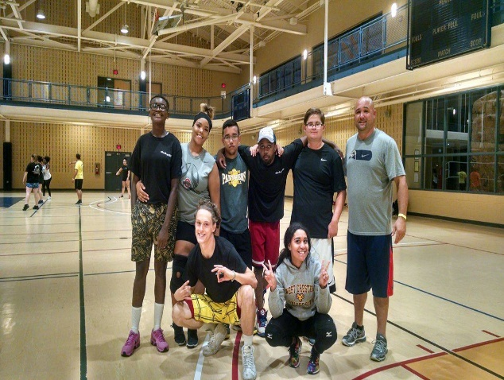
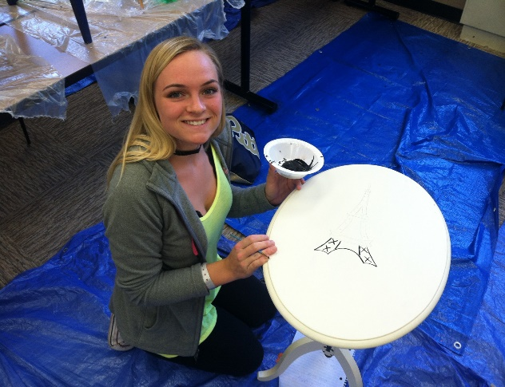
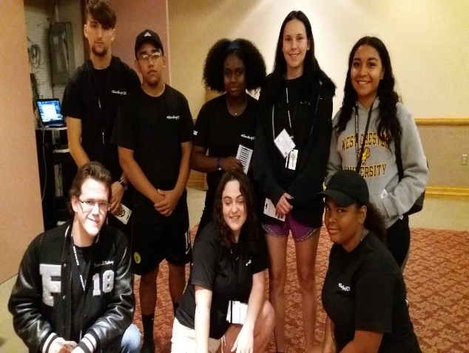
Typical YAB Member
Ages 16-21
Current or former youth in the foster care system
Interested in Advocacy work
Interested in making new friends

Slide 6
The YAB Impact
Over 200 youth and alumni of the child welfare system throughout Pennsylvania are members of the YAB
Over the course of a year, YAB members present at numerous venues reaching over 800 participants
YAB members participate in a wide variety of statewide projects and initiatives including:
  Child Family Service Review (CFSR)
  Statewide Adoption and Permanency Network
  PA Child Welfare Council

Slide 7
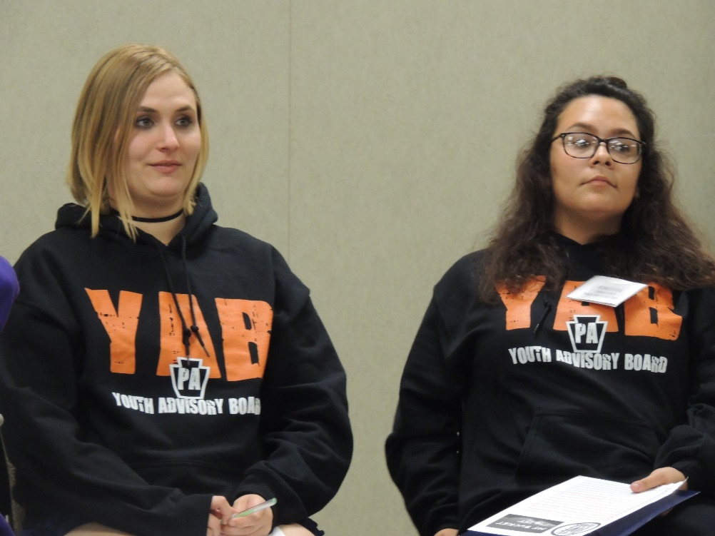
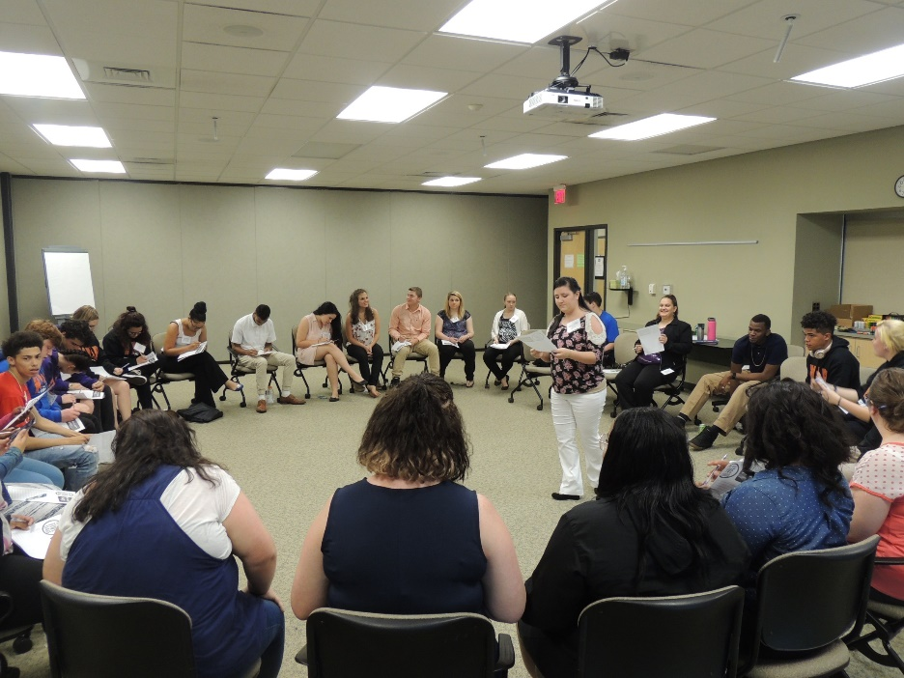
YAB Structure
Youth driven
Staff supported
Statewide/region/ local

Slide 8
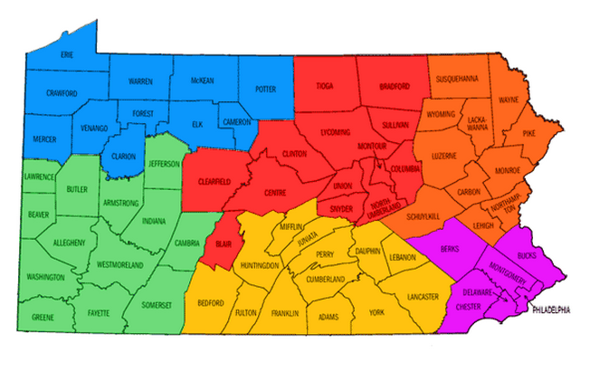
Regional Youth Advisory Boards

Slide 9
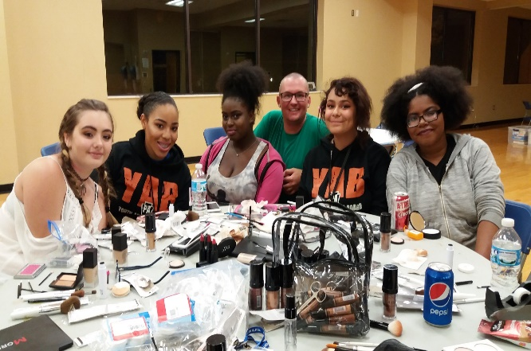
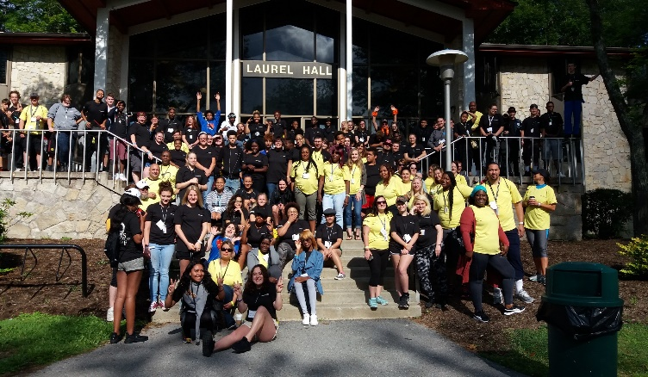
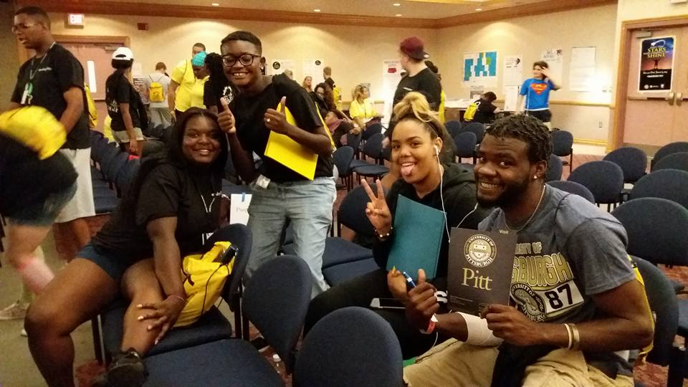
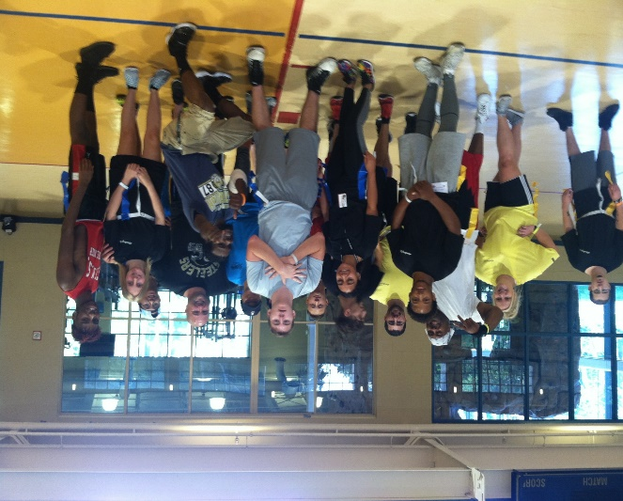
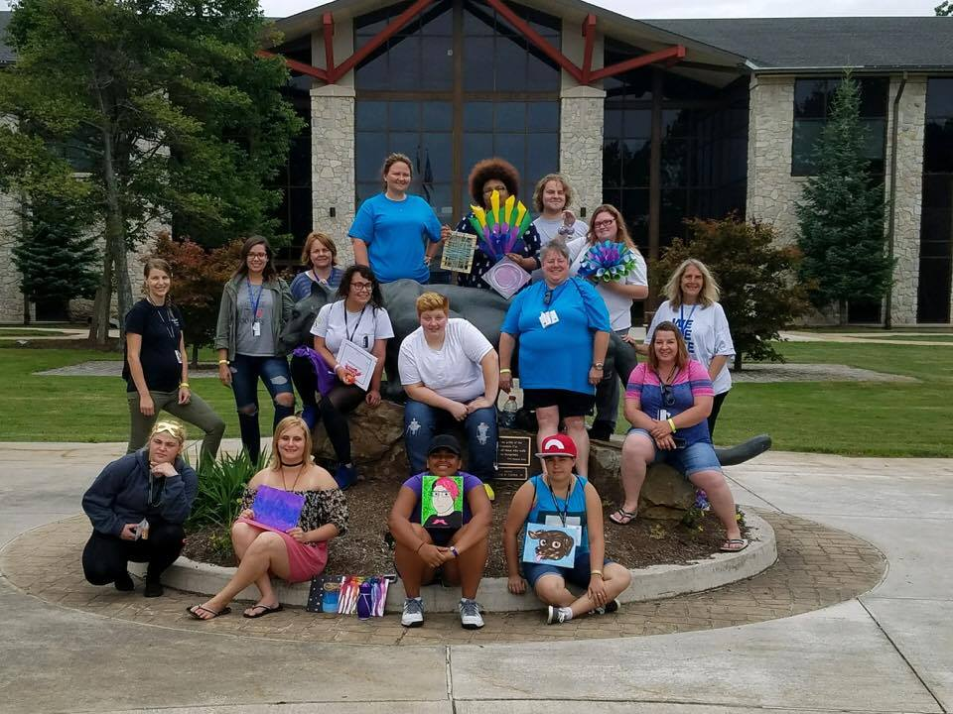
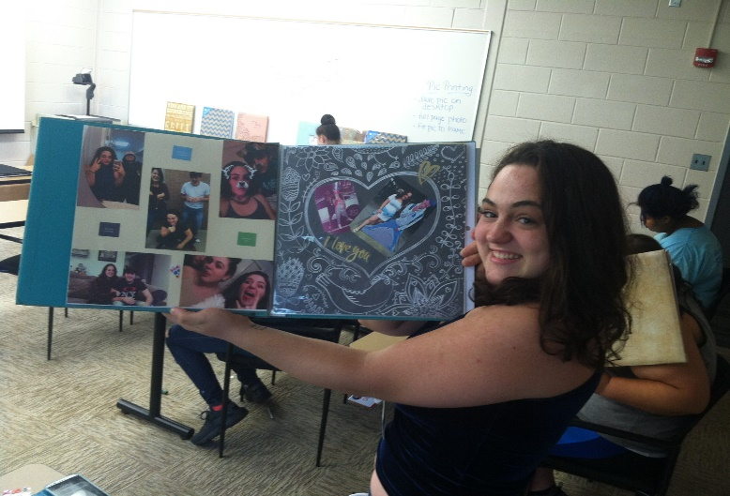
2017 Older Youth Retreat

Slide 10
YAB Media
Facebook: https://www.facebook.com/pages/Pennsylvania-Youth-Advisory-Board/371359021197?ref=hl
Website:
www.independentlivingpa.org
YouTube
The Blast:
2017/2018 YAB Blast Holiday Edition
Older Youth Retreat Video

Slide 11
Professional Development
Leadership
Strategic Sharing
Know Your Rights and Advocacy
How to Conduct yourself in court
Time Management
Project Planning
Great for the Resume
Networking and making connections

Slide 12
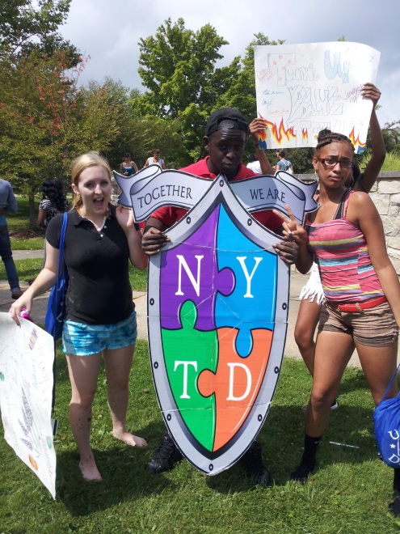
National Youth in Transition Database
(NYTD)
NYTD is a survey designed to track how
states serve older youth, and to measure
how well states are helping foster youth
prepare for adulthood.
Your feedback completes the puzzle

Slide 13
Getting Started
Youth panels
Youth Submissions
IL Retreat
A project/product or community service project… join up with the region or area programs that are existing. (5k, homeless shelters, feeding the hungry, senior living homes)
Visit another existing YAB: A learning opportunity to get ideas on structure.
Helpful to have someone with advocacy/child welfare experience, getting alumni experience to motivate/inspire youth.

Slide 14
Lessons learned

Slide 15
Discussion question & answer

Slide 16
For more Information
Pennsylvania Child Welfare Resource Center
Marvin Butts
Youth Quality Improvement Specialist
mdb122@pitt.edu
(717) 795-9048 Ext. 50285

